Slide 1


DESIGN AND VERIFICATION OF A HYBRID APPROXIMATE PARALLEL PREFIX
ADDER
Presented By -
D. Harsha Vardhini
V. Lakshmi Revanth Kumar
Batch – PGDVD 18

Slide 2
Contents
Introduction
Objective
Design Methodologies
Flow Chart
Advantages
Applications
Results
Conclusion

Slide 3
Introduction
Parallel prefix adders (PPAs) are a category of high-performance digital adders used extensively in VLSI circuits. These adders are designed to perform fast arithmetic operations, especially addition, with optimized speed, area, and power consumption.
They are widely used in VLSI circuits such as microprocessors, digital signal processors, etc., and some of the design methodologies used for building these adders are the Brent-Kung, Kogge-Stone, Sklansky, and Ladner-Fisher adders.
Approximate parallel prefix adders instead of exact parallel prefix adders for certain applications where exactness is not critical and some amount of error can be tolerated. These approximate adders are designed to provide approximate output with lower area and power consumption and higher speed compared to exact parallel prefix adders..

Slide 4

Objective
To design a hybrid approximate parallel adder that leverages the efficiency of hybrid adder architectures and approximation techniques, aiming to reduce area and power consumption while enhancing speed, and to verify its functionality and performance through comprehensive testing.

Slide 5

What we designed…
We designed hybrid approximate parallel adder with two adders.
They are : 1.Ladner-Fischer adder
2.Sklansky adder
By using these adders, our hybrid adder can work with more speed, less delay and low power consumption.

Slide 6
Ladner Fischer Adder
The Ladner-Fischer Adder is a type of parallel prefix adder, a class of binary adders that are designed for fast addition in digital circuits. It is used primarily in computer arithmetic to perform addition operations with lower latency compared to traditional ripple-carry adders.
Utilizes a hierarchical tree-like structure to compute carry bits in parallel, minimizing critical path delay.
Faster than ripple-carry adders with fewer gates.
It is often chosen when a tradeoff between area and speed is required.

Slide 7
Sklansky Adder
The Sklansky adder is another type of parallel prefix adder that is designed to perform fast addition of binary numbers.
It uses a binary tree structure to compute carry signals in parallel.
It is also known as the divide-and-conquer adder because of its approach to splitting and combining carry computations.
The Sklansky adder is ideal in situations where speed is prioritized over design complexity, such as in high-performance arithmetic units in processors.

Slide 8
Hybrid Adder
Combines Ladner-Fischer and Sklansky adders for optimized performance and efficiency.
Ladner-Fischer Adder: It’s provides a balanced tradeoff between logic depth and gate count, making it efficient for generating partial results in local groups.
Sklansky Adder: It has a minimal logic depth for global carry computation, ensuring fast carry propagation across groups.
Addresses fanout issues in Sklansky and wiring complexity in Ladner-Fischer, improving performance and area efficiency.

Slide 9
Flow chart
Start
Inputs A & B
Compute Generate (G) and Propagate (P) signals
Compute Local Prefix for First Half Bits
Compute Local Prefix for Next Half Bits
Compute Global Prefix
Compute Carry Signals
Compute Overall Sum
End

Slide 10
Advantages
Performance optimization
Scalability
Reduced fanout
Customizable tradeoffs

Slide 11
Applications
ASIC and FPGA designs
High-performance processors
Digital signal processing systems
Real time embedded systems
Signal transmission units

Slide 12
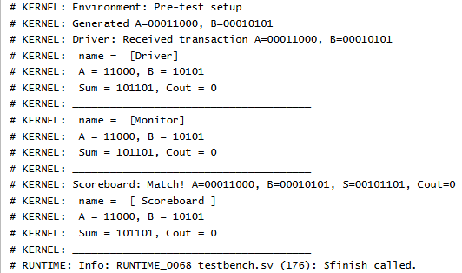
Results
Fig: Output for Hybrid Adder

Slide 13
Conclusion
The Hybrid Adder combining Ladner-Fischer and Sklansky architectures offers a powerful solution for high-performance digital arithmetic. By leveraging the strengths of both structures, this design achieves an optimized balance between speed, area, and power consumption, making it suitable for a wide range of applications in modern computing and signal processing. In conclusion, hybrid adders exemplify how tailored combinations of established designs can meet the growing demands of modern digital systems, offering both performance gains and resource efficiency. Their adaptability makes them an indispensable tool in advancing the field of digital arithmetic.

Slide 14

☺

